Slide 1
Find Mii Project and OpenCV Tutorial
2012.10.12

Slide 2
Overview
FindMii Project
OpenCV Introduction
HighGUI
Basic Operations
AdaBoost
Face Detection
Optical Flow
Template Matching
Local Feature

Slide 3
FindMii Project
It’s the default project of this class.
Matlab
OpenCV
If you prefer OpenCV, there is a tutorial later.
Dates
Oct 16 (11:59pm): Finalizing team members and proposal submission.
Nov 6 (11:59pm): Project milestone.
Dec 3 (11:59pm): Code and writeup due.
Dec 6 (time 1-3 pm): Course project presentation.

Slide 4
FindMii Project
4 tasks
Task 1 : Find this Mii
Task 2 : Find 2 look-alikes
Task 3 : Find n odd Miis out
Task 4 : Find the fastest Mii
3 levels
Easy, medium, hard
3x4 = a lot
Min-requirement : 3 different tasks (1 level for each)

Slide 5
FindMii Data
4 .m files
ClickMii.m (visualize your results)
FindMiiMain.m (main script)
FindMiiTask1Level1.m (dummy function)
PlayMii.m (play video)
opencvexample.cpp and Makefile (for OpenCV)
Training data
/afs/ir/class/cs231a/findmii/data
Ground truth
/afs/ir/class/cs231a/findmii/gt

Slide 6
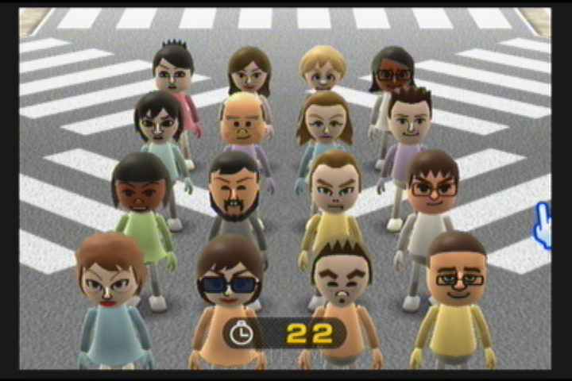
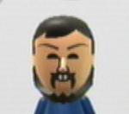
Task 1: Find This Mii
Level 1 (Easy)

Slide 7
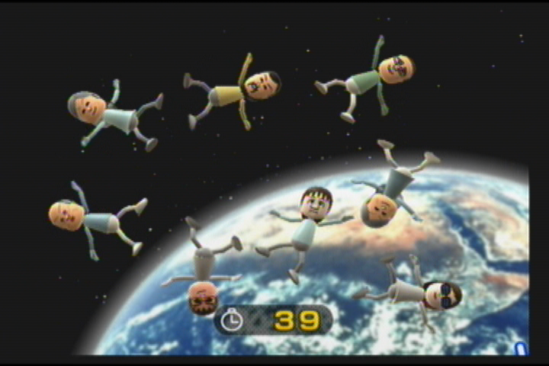
Task 2: Find 2 Look-alikes
Level 2 (Medium)

Slide 8
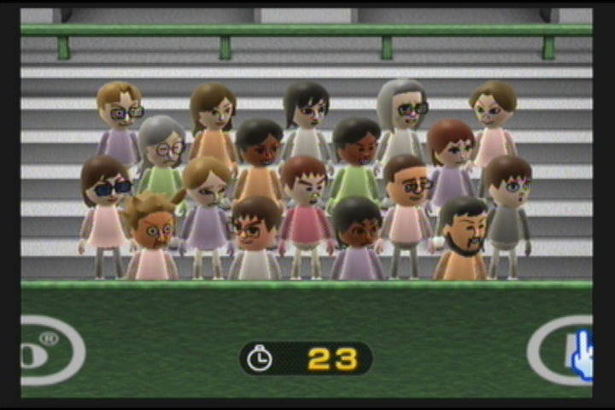
Task 3: Find n Odd Miis Out
Level 1 (Easy)

Slide 9
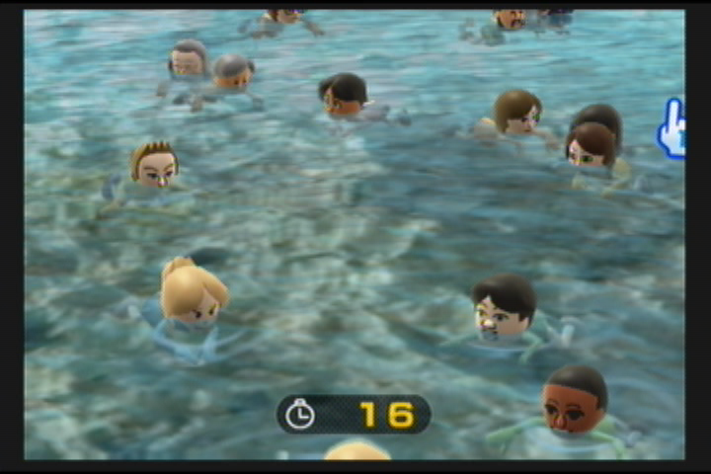
Task 4: Find the Fastest Mii
Level 3 (Hard)

Slide 10
Compile with OpenCV
You program should compile and run properly on the ‘corn’ clusters, using the following header file and library file path:
/afs/ir/class/cs231a/opencv/include
/afs/ir/class/cs231a/opencv/lib
Please follow the example given by Makefile and 'opencvexample.cpp' in the project AFS path.
Windows executable or Visual Studio projects will NOT work.

Slide 11
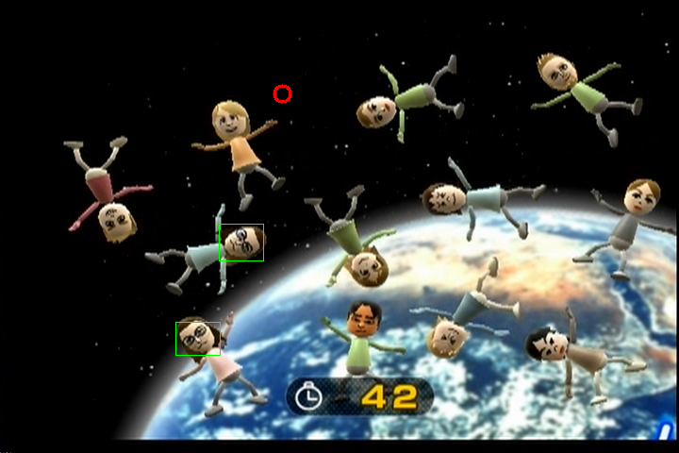
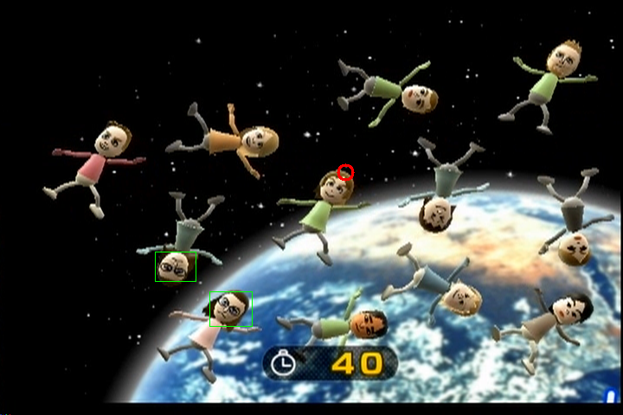
Evaluations
click = [12 300 100; 66 400 200];
ClickMii(‘data/t2l2.avi’, ‘gt/t2l2.gt’, click);

Slide 12
Scoring
For a given task & level
A correct click on frame 1 is worth 1 point, each frame thereafter is discounted by 0.99. And you can NOT access (even read into memory) any frame after the one you made your final click for a task. Score is averaged over multiple clicks if applicable. For example, if a task requires two clicks, you return 1st click at frame 5, and 2nd click at frame 20 (both of them are correct), your score would be (0.99^4 + 0.99^19)/2 = 0.8934. In this case, you can NOT access any frame after frame 20.
For a given task
The highest score you achieve on the 3 levels. When comparing the scores on different levels, scores on level 2 are multiplied by 1.5, and scores on level 3 are multiplied by 2. For example, for task 1, your score is 1.0 on level 1, and 0.77 on level 2, and you are not doing level 3. Your final score for task 1 would be max(1*1, 0.77*1.5, 0*2) = 1.155.
For the challenge
Sum up your scores in all 4 tasks.

Slide 13
OpenCV – Introduction
OpenCV stands for the Open Source Computer Vision Library.
It was founded at Intel in 1999, went through some lean years after the .bust but is now under active development, now receiving ongoing support from Willow Garage.
OpenCV is free for commercial and research use.
It has a BSD license. The library runs across many platforms and actively supports Linux, Windows and Mac OS.
OpenCV was founded to advance the field of computer vision.
It gives everyone a reliable, real time infrastructure to build on. It collects and makes available the most useful algorithms.

Slide 14
OpenCV - Features
Cross Platform
Windows, Linux, Mac OS
Portable
iPhone
Android.
Language Support
C/C++
Python

Slide 15
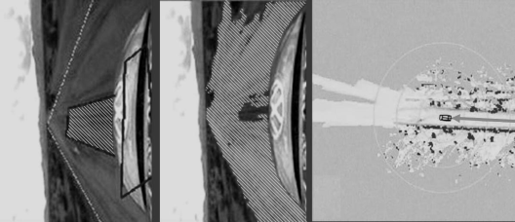
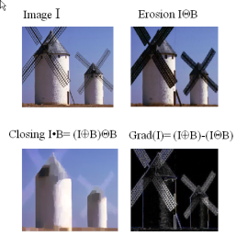
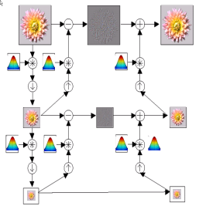
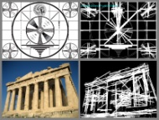
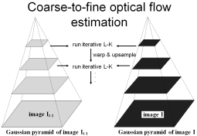
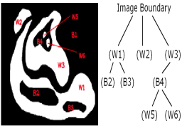
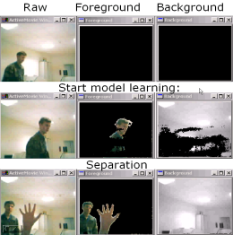
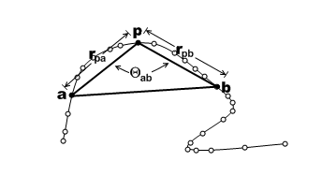
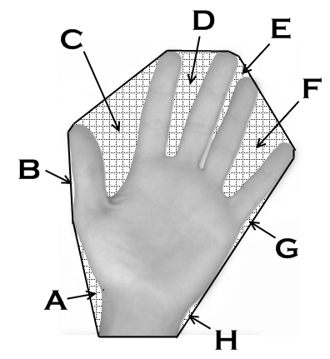
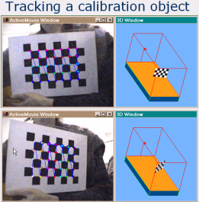
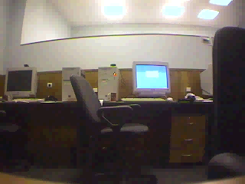
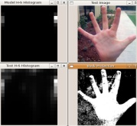
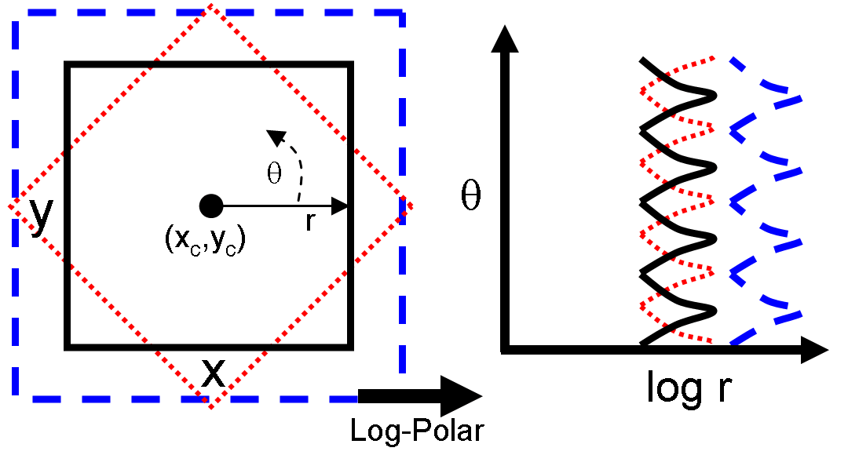
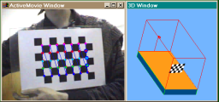
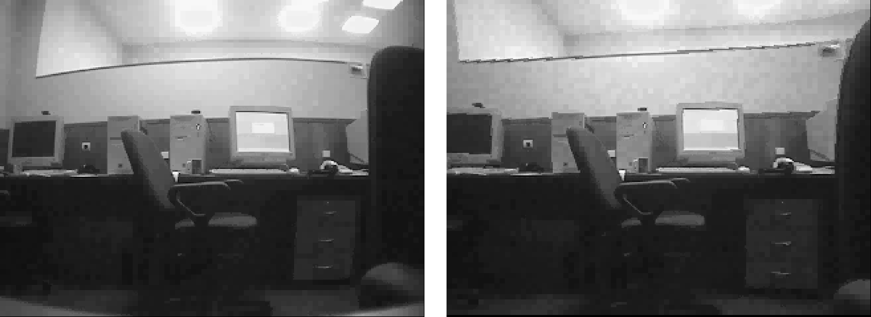
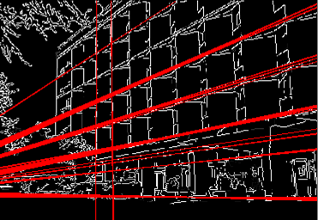
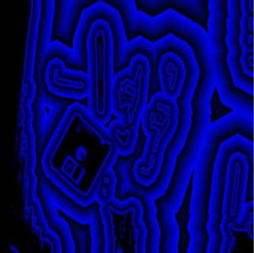
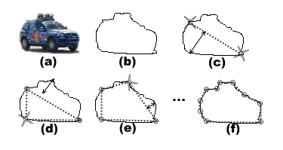
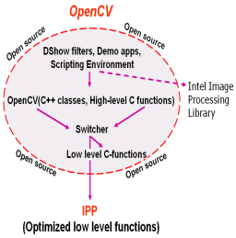
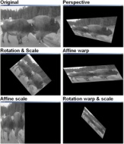
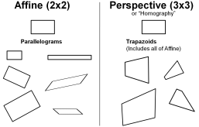
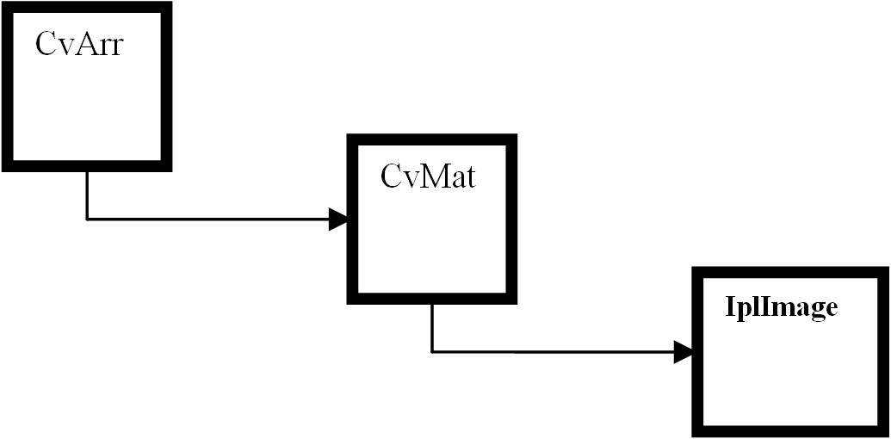
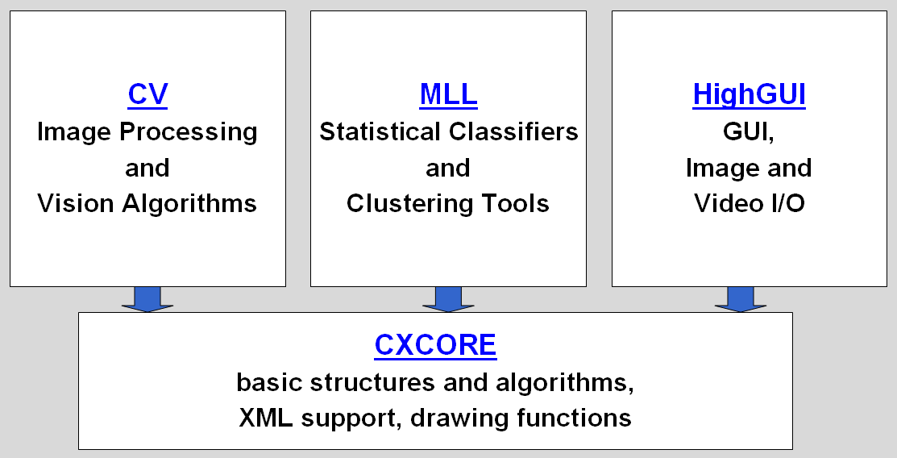
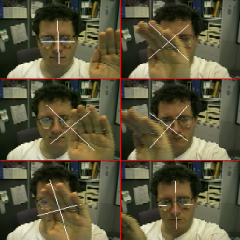
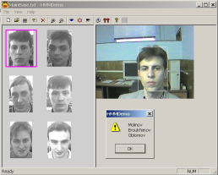
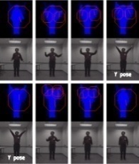
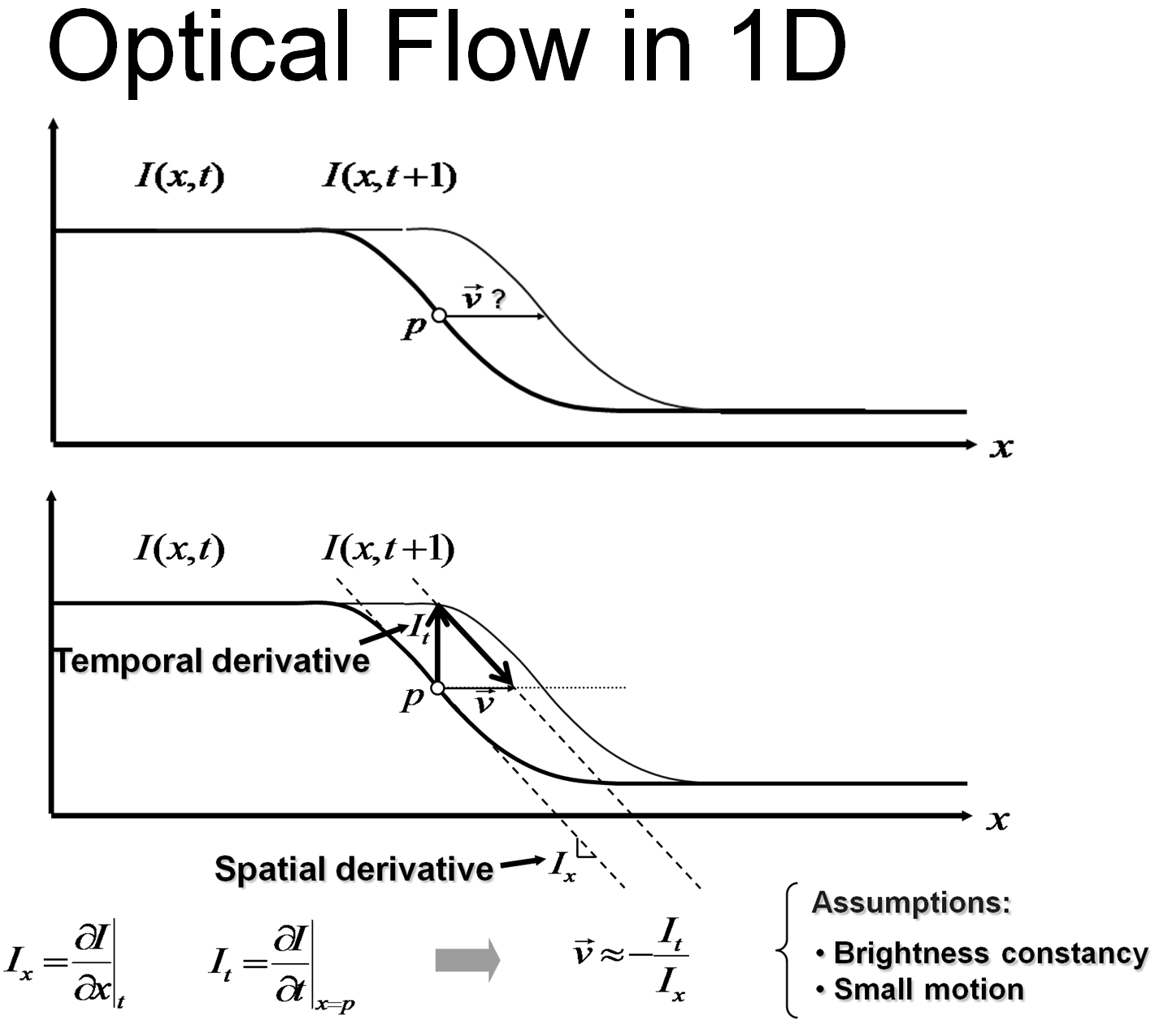
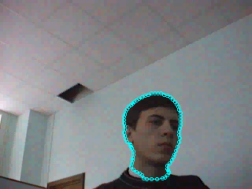
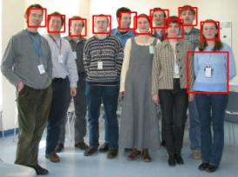
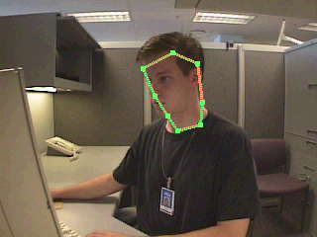
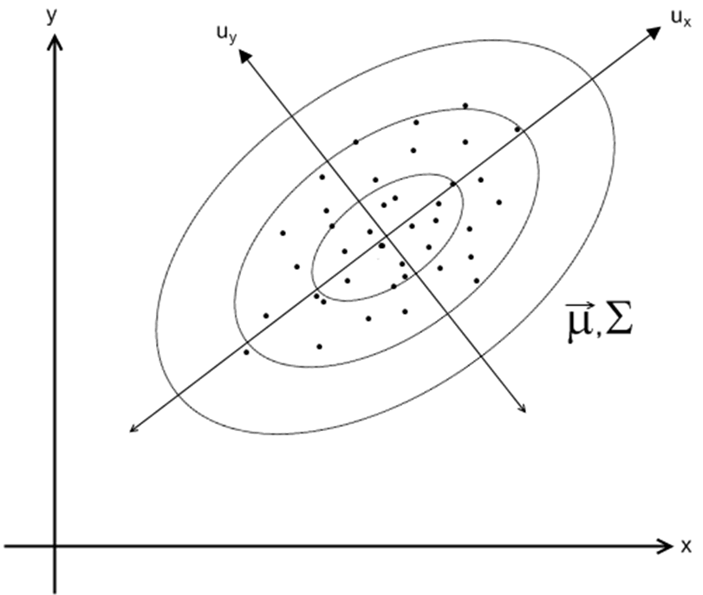
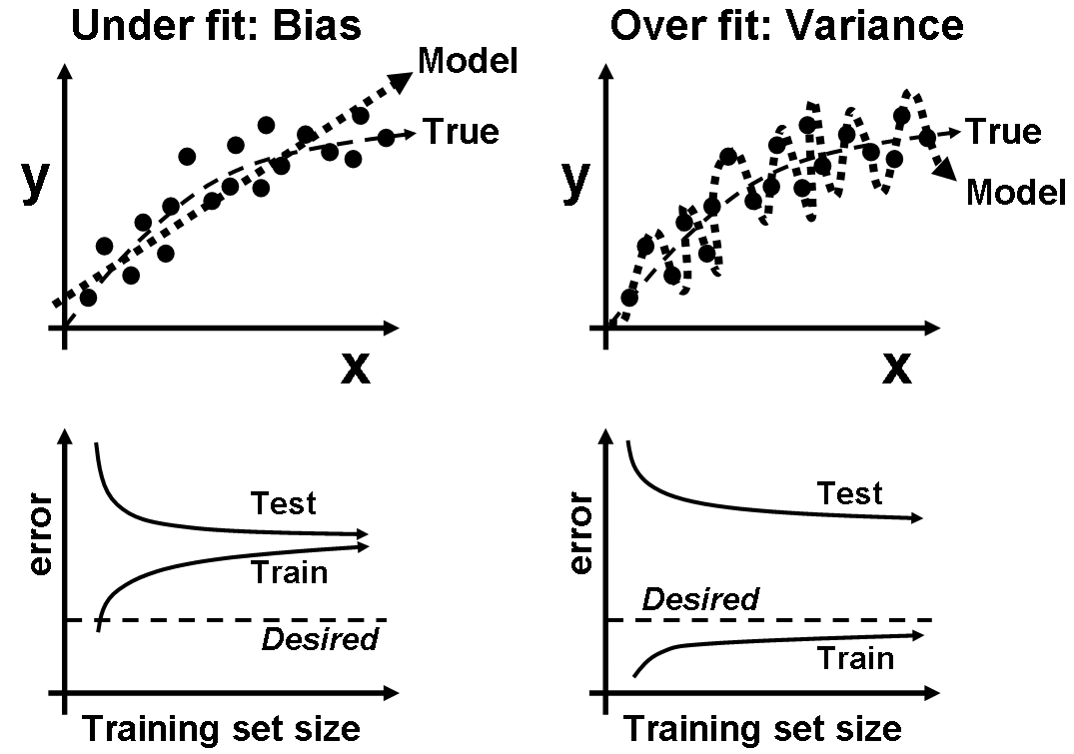
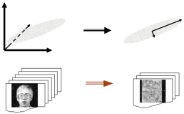
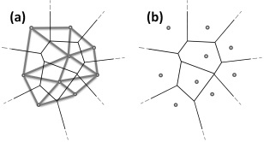
OpenCV Overview:
Robot support
> 500 functions
opencv.willowgarage.com
General Image Processing Functions
Image Pyramids
Geometric
Descriptors
Segmentation
Camera
Calibration,
Stereo, 3D
Features
Transforms
Utilities and
Data Structures
Tracking
Machine Learning:
Detection,
Recognition
Fitting
Matrix Math
Slide Courtesy OpenCV Tutorial Gary Bradski

Slide 16

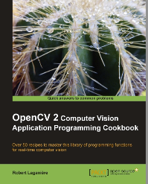
OpenCV – Getting Started
Download OpenCV
http://opencv.org
Install from macports/aptitude
Setting up
Comprehensive guide on setting up OpenCV in various environments at the official wiki.
Online Reference:
http://docs.opencv.org
Two books

Slide 17
HighGUI
HighGUI
Image I/O, rendering
Processing keyboard and other events, timeouts
Trackbars
Mouse callbacks
Video I/O

Slide 18
HighGUI: OpenCV Functions
void cv::namedWindow(const string& winname, int flags=WINDOW_AUTOSIZE);
Creates window accessed by its name. Window handles repaint, resize events. Its position is remembered in registry.
void cv::destroyWindow(const string& winname);
void cv::imshow(const string& winname, cv::Mat& mat);
Copies the image to window buffer, then repaints it when necessary. {8u|16s|32s|32f}{C1|3|4} are supported.
Only the whole window contents can be modified. Dynamic updates of parts of the window are done using operations on images, drawing functions etc.

Slide 19
HighGUI: OpenCV Functions
Mat imread(const string& filename, int flags=1);
loads image from file, converts to color or grayscale, if need, and returns it (or returns empty cv::Mat()).
image format is determined by the file contents.
bool imwrite(const string& filename, Mat& image);
saves image to file, image format is determined from extension.
Example: convert JPEG to PNG
cv::Mat img = cv::imread(“picture.jpeg”);
if(!img.empty()) cv::imwrite( “picture.png”, img );

Slide 20
HighGUI Sample Code
Example code: load an image from disk and display it on the screen.
#include <opencv2/opencv.hpp>
int main( int argc, char* argv[] ) {
cv::Mat image = cv::imread( argv[1] );
cv::namedWindow( “Example1”,CV_WINDOW_AUTOSIZE );
cv::imshow( “Example1”, image );
cv::waitKey(0);
cv::destroyWindow( “Example1” );
return 0;
}

Slide 21
HighGUI Sample Code
Example code: load a video file and process each frame.
#include <opencv2/opencv.hpp>
int main( int argc, char* argv[] ) {
cv::VideoCapture capture("filename.avi");
if (!capture.isOpened()) return 1;
cv::Mat frame;
while (true) {
capture >> frame; if(!frame.data) break;
//process the frame here
}
capture.release();
return 0;
}

Slide 22
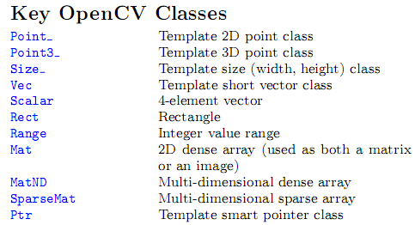
Key Classes

Slide 23
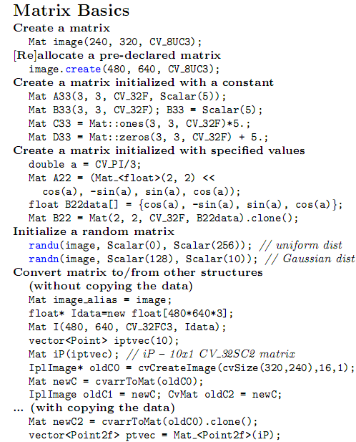

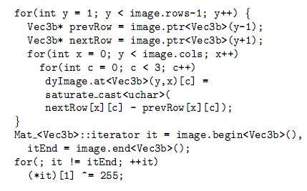
Manipulate an Image (Mat)
Mat does reference counting, so it does
the right thing when it goes out of scope
you can also easily make STL vectors or maps
out of Mat.

Slide 24
AdaBoost
Boosting
Covered in Lecture 2 (Sept 7).
Can a set of weak learners create a single strong learner?
Weak classifiers weighted by its accuracy.
Adaptive Boosting
Subsequent classifiers focus on instances misclassified by previous classifiers.
Formulated by Yoav Freund and Robert Schapire.
Y. Freund, R.E. Schapire. A Decision-theoretic Generalization of On-line Learningand an Application to Boosting. Journal of Computer and System Sciences. 1997

Slide 25
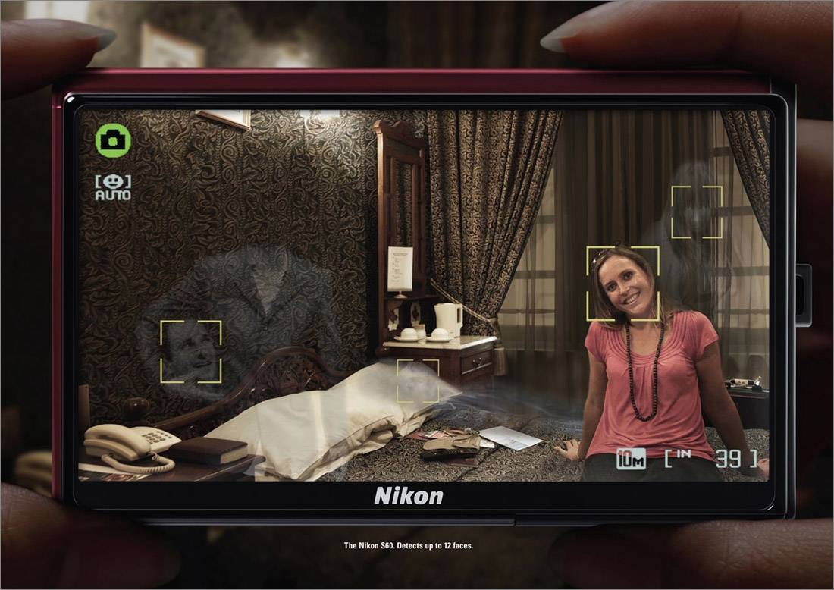
Face Detection
Photo Courtesy Nikon Corp.

Slide 26

Face Detection
Slide a window over the image
Also change the size of the window
Extract features for each window
Classify each window into face/non-face
?
Features
Classify
+1 face
?
-1 not face
?
x
F(x)
y

Slide 27
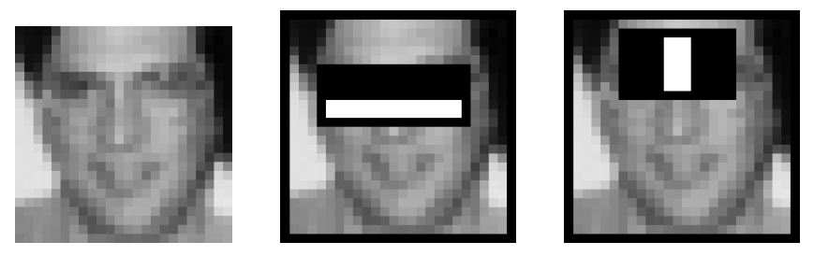
Face Detection: Viola-Jones
Robust and fast
Introduced by Paul Viola and Michael Jones
http://research.microsoft.com/~viola/Pubs/Detect/violaJones_CVPR2001.pdf
Haar-like Features
Use AdaBoost to select good classifiers and combine them

Slide 28
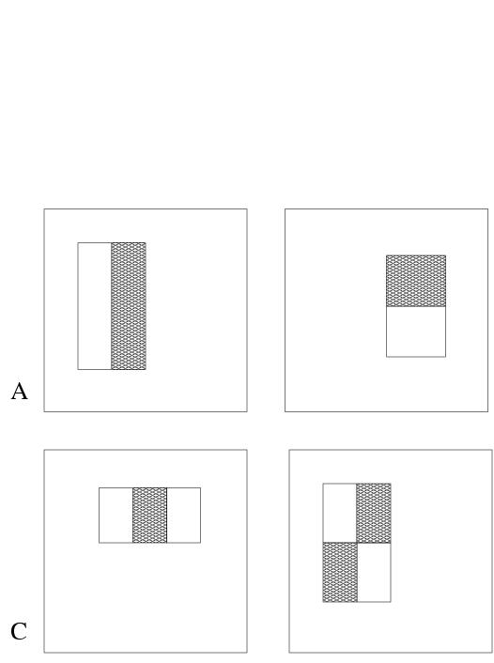
Face Detection: Viola-Jones
Haar-like features
Rectangular blocks, white or black
3 types of features:
two rectangles: horizontal/vertical
three rectangles
four rectangles
In 24x24 window: 180,000 possible features
Simple weak classifier

Slide 29
HighGUI Sample Code
AdaBoost
Given set of “weak” classifiers:
Pick best one.
Reweight training examples, so that misclassified images have larger weight.
Reiterate; then linearly combine resulting classifiers.
Result
A classifier with 200 rectangle features was learned using AdaBoost.
95% correct detection on test set with 1 in 14084 false positives.
Less susceptible to over-fitting.

Slide 30
Face Detection: Cascaded Classifier
A 1 feature classifier achieves 100% detection rate and about 50% false positive rate.
A 5 feature classifier achieves 100% detection rate and 40% false positive rate (20% cumulative)
using data from previous stage.
A 20 feature classifier achieve 100% detection rate with 10% false positive rate (2% cumulative)
IMAGE
SUB-WINDOW
50%
20%
2%
1 Feature
5 Features
20 Features
FACE
F
F
F
NON-FACE
NON-FACE
NON-FACE

Slide 31
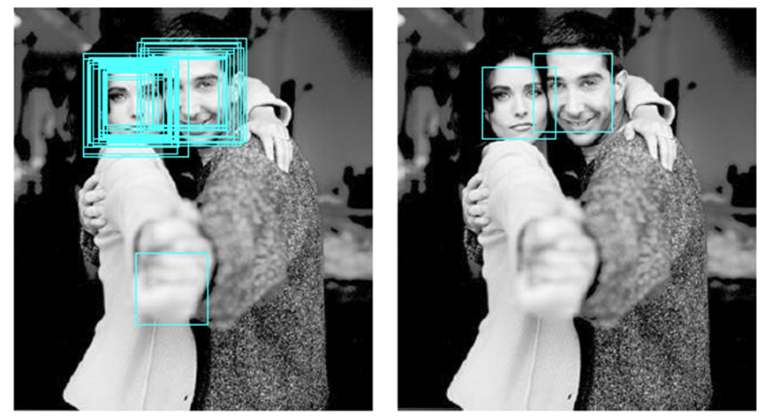
Face Detection: Non-Maximum Suppression
Thin out the multiple responses.
Suppress spurious responses.

Slide 32
Face Detection
Good news – OpenCV comes with an implementation of Viola-Jones!
Training
The training face images are provided.
opencv_traincascade (supports Harr and LBP features).
Details are at http://docs.opencv.org/trunk/doc/user_guide/ug_traincascade.html
Detection
A good reference: http://docs.opencv.org/doc/tutorials/objdetect/cascade_classifier/cascade_classifier.html

Slide 33
Face Detection: OpenCV Functions
bool CascadeClassifier::load(const string& filename);
Loads a classifier from a file.
void CascadeClassifier::detectMultiScale(const Mat& image, vector<Rect>& objects, double scaleFactor=1.1, int minNeighbors=3, int flags=0, Size minSize=Size(), Size maxSize=Size());
Detects objects of different sizes in the input image. The detected objects are returned as a list of rectangles.

Slide 34
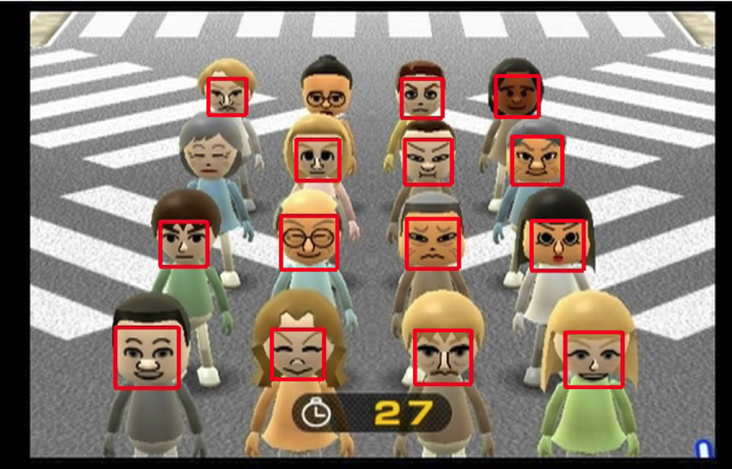
Face Detection: Example

Slide 35
Optical Flow – Theory
Optical flow: the apparent motion of brightness patterns in the image.
Will be covered in Lecture 13 (Nov 8)
May not be the same as the actual motion - aperture problem.
Human vision does optical flow analysis all the time – being aware of movement around them.
Use cases:
Find objects from one frame in other frames.
Determine the speed and direction of movement of objects.
Determine the structure of the environment.

Slide 36

Optical Flow – Theory (Lucas-Kanade)
Key assumption
Brightness constancy
I(x+u,y+v,t+1)=I(x,y,t)
Image measurements in a small region remain the same although their location may change.

Slide 37


Optical Flow – Theory (Lucas-Kanade)

Slide 38
Optical Flow: OpenCV Functions
void goodFeaturesToTrack(Mat& image, vector<Point2f>& corners, int maxCorners, double qualityLevel, double minDistance);
Determines strong corners on an image.
void cornerSubPix(Mat& image, vector<Point2f>& corners, Size winSize, Size zeroZone, TermCriteria criteria);
Refines the corner locations.
void calcOpticalFlowPyrLK(Mat& prevImg, Mat& nextImg, vector<Point2f>& prevPts, vector<Point2f>& nextPts, vector<uchar>& status, vector<float>& err);
Calculates an optical flow for a sparse feature set using the iterative Lucas-Kanade method with pyramids.

Slide 39

Optical Flow - Example

Slide 40

Template Match
Template matching is a technique for finding areas of an image that match (are similar) to a template image (patch).
We need two primary components:
Source image (I): The image in which we expect to find a match to the template image.
Template image (T): The patch image which will be compared to the template image.
Our goal is to detect the highest matching area.

Slide 41
Template Match: OpenCV Functions
void matchTemplate(Mat& image, Mat& templ, Mat& result, int method);
The function slides through image, compares the overlapped patches of size w*h against templ using the specified method and stores the comparison results in result .
After the function finishes the comparison, the best matches can be found as global minimums (when CV_TM_SQDIFF was used) or maximums (when CV_TM_CCORR or CV_TM_CCOEFF was used) using the minMaxLoc() function.
void minMaxLoc(Mat& src, double* minVal, double* maxVal=0, Point* minLoc=0, Point* maxLoc=0, InputArray mask=noArray());
Finds the global minimum and maximum in an array.

Slide 42
Local Features
Detection:
Description:
Detectors available
SIFT
SURF
FAST
ORB
MSER
Descriptors available
SIFT
SURF
ORB
BRIEF

Slide 43
Local Features Sample Code
Detect interest points and extract descriptors from the given image.
cv::Mat img = cv::imread(“test.jpg”);
cv::Ptr<cv::FeatureDetector> detector = cv::createDetector( “FAST” );
cv::Ptr<cv::DescriptorExtractor> descriptorExtractor = cv::createDescriptorExtractor( “SURF” );
std::vector<cv::KeyPoint> keypoints;
detector->detect( img, keypoints );
cv::Mat descriptors;
descriptorExtractor->compute( img, keypoints, descriptors );

Slide 44
Local Features Sample Code
Match descriptors from two images.
Assume that the descriptors of two images are stored in descriptor1 and descriptor2 already.
cv::Ptr<cv::DescriptorMatcher> descriptorMatcher = cv::createDescriptorMatcher( "BruteForce" );
std::vector<cv::DMatch> matches;
descriptorMatcher->add( descriptors2 );
descriptorMatcher->match( descriptors1, matches );

